Slide 1

DEPARTMENT OF COMPUTER ENGINEERING
GamerHive
(Group no: 3)
Student names:
Atharva Jagtap (Roll no. 46)
Mit Jain (Roll no. 51)
Kartik Kanchan (Roll no. 58)
Anurag Kawade (Roll no. 60)
Under the Guidance of:B. M. Colaco

Slide 2
Problem statement
Objective
To design a website dedicated to game lovers and to make a database for it.
-To provide information about various games
-To provide player opinions on the games
-To provide the statistics about the sales of the games
-To bring the gaming community closer

Slide 3
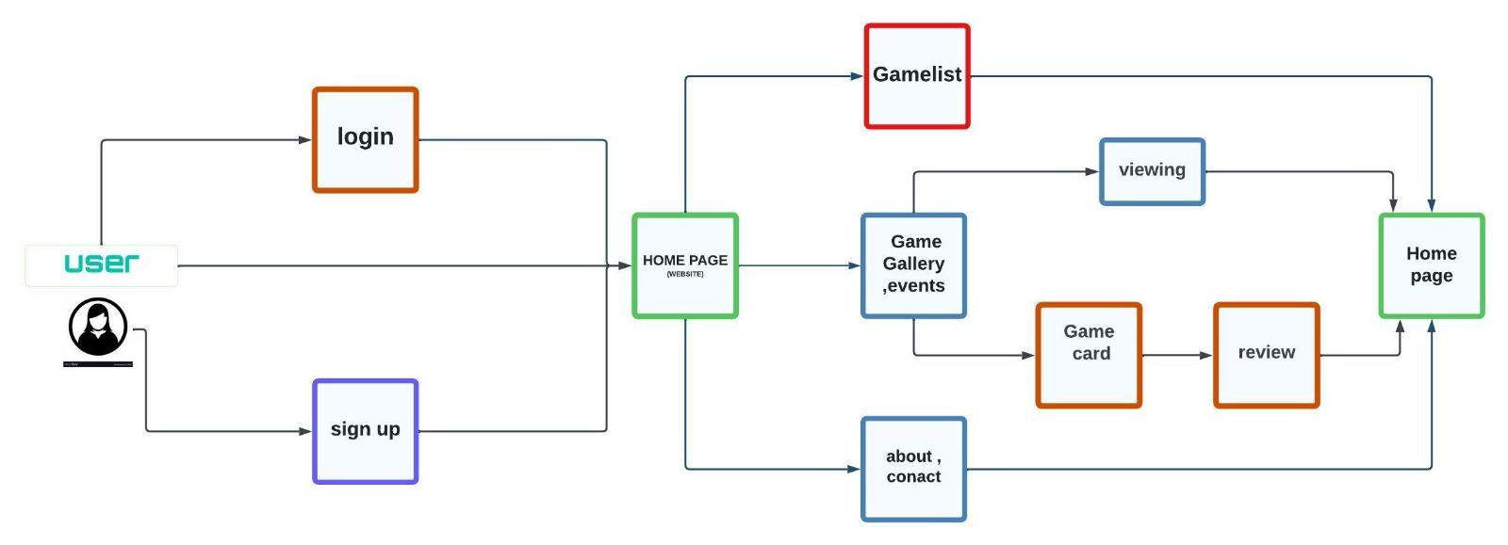
ER design

Slide 4
Proposed System
User: ID, Favourites, Reviews, Sign-in
Platform: Console, PC, Hand-helds
Game: Name, Release date, Image, Downloads, Genre, Upcoming
To-be-played: Name, Time of being added,
Search bar
Events: Game of the month, Fan favourites, Trending

Slide 5
Technological Stack
There are 3 ways to implement css commands into your site: 1. Use one CSS file for all your pages. This is the best way to do it. 2. Integrate CSS commands into the head of each of your documents. 3. Use the style attribute to put CSS code directly into HTML element
Where do you implement CSS? You can embed an internal style sheet by adding CSS to the head section of your HTML doc. Or you can link to an external style sheet that will contain all your CSS separate from your HTML.
Java is commonly used language for web development, especially on the server-side. Java web applications are distributed applications that run on the internet. Web development with Java allows us to create dynamic web pages where users can interact with the interface.
XAMPP helps a local host or server to test its website and clients via computers and laptops before releasing it to the main server. It is a platform that furnishes a suitable environment to test and verify the working of projects based on Apache, Perl, MySQL database, and PHP through the system of the host itself.

Slide 6
References 1
https://www.imdb.com/
https://in.ign.com/
https://www.rottentomatoes.com/
CAR CATALOG

